Slide 1



2020 - 086
Centralized Hub for Securing A
Network of IoT
Devices
Progress Presentation 2
10/7/2020
1

Slide 2




Introduction
“ARCSECURE” is a product which consists of 4 modules,
Botnet Detection and Mitigation.
DDoS Detection and Mitigation.
Malware Detection and Mitigation.
User Authentication and Authorization.
These 4 modules will have functionalities as the name itself suggests.
This product is mainly targeted at Small Office/Home Office (SOHO) environments.
2

Slide 3
Research Problem
There has been a rise in attacks when it comes to a network of Internet of Things (IoT).
Namely Botnet, DDoS, Malware or even instances where an attacker would disguise as a legitimate user and try to get access to the network.
Therefore, in the current context of a SOHO environment, it is a great concern to secure the network and the devices connected to it to provide protection to the information being held by it.
Hence there exists a need for a well-rounded product which address this problem.
3

Slide 4

Research Objective
Establish Mechanisms to detect and mitigate Botnet Attacks.
Establish Mechanisms to detect and mitigate DDoS Attacks.
Establish Mechanisms to detect and mitigate Malware.
Establish Mechanisms to Authenticate and Authorize users.
4

Slide 5


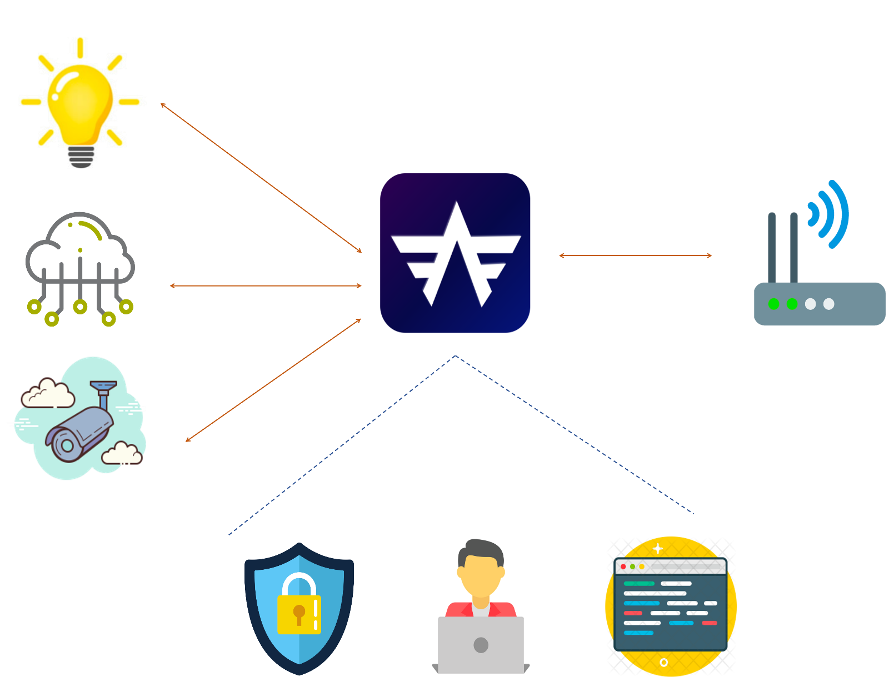
Overall System Diagram
5

Slide 6




IT17009614 - A.M.I.S Abeykoon
Bachelor of Science (Hons) Degree in Information Technology Specialized in Cyber Security
IT17009614 - A.M.I.S Abeykoon 2020-086
10/7/2020
6

Slide 7
BACKGROUND/RESEARCH GAP
The large number of insecure IoT devices with high computation power make them an easy and attractive target [1].
Mirai and Bashlite is the common botnets among major IOT attacks.
Bots can automatically scan entire network ranges and propagate themselves using known vulnerabilities [2].
Botnets typically establish communication with one or more remote servers that hackers use to retrieve private information [2].
The challenge is to implement a mechanism to prevent network layer-based vulnerabilities.
Addressing this challenge will require scalable security solution optimized for the IoT ecosystem.
IT17009614 - A.M.I.S Abeykoon 2020-086
10/7/2020
7

Slide 8

RESEARCH PROBLEM
How to mitigate botnet attacks and create a secure connection between the internet and ensure that IoT devices not exploit as zombies.
IT17009614 - A.M.I.S Abeykoon 2020-086
10/7/2020
8

Slide 9
SPECIFIC AND SUB OBJECTIVES
Capture incoming packets
Extract features out of the packets
Map the extracted features for machine learning
Training & Testing intrusion detection module using machine learning
Implement anomaly detection model
Implement network traffic monitoring system
IT17009614 - A.M.I.S Abeykoon 2020-086
10/7/2020
9

Slide 10
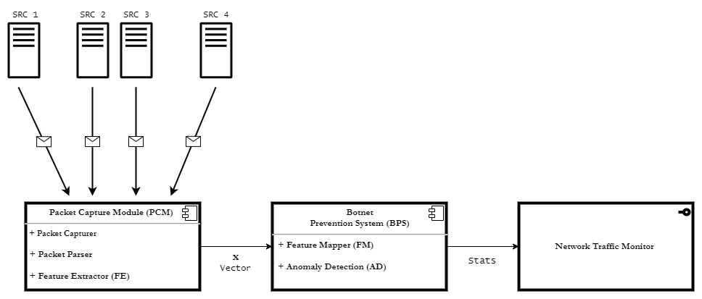
METHODOLOGY AND SYSTEM DIAGRAM
IT17009614 - A.M.I.S Abeykoon 2020-086
10/7/2020
10

Slide 11

ACHIEVEMENTS
Implement a packet capture module
Prepare and clean the dataset for use.
Trained and tested the machine learning model for anomaly detection.
Create a method for blacklist IPs.
Deploy machine learning model in web environment and desktop environment.
Implement mechanism to create, view and maintain traffic logs.
IT17009614 - A.M.I.S Abeykoon 2020-086
10/7/2020
11

Slide 12

REFERENCES
[1] E. Bertino and N. Islam, "Botnets and Internet of Things Security," in Computer, vol. 50, no. 2, pp. 76-79, Feb. 2017. [Accessed 22 02 2020].
[2] Constantinos Kolias, Georgios Kambourakis, Angelos Stavrou, Jeffrey Voas, " DDoS in the IoT: Mirai and Other Botnets," in Computer, vol. 50, no. 7, Feb. 2017. [Accessed 22 02 2020].
IT17009614 - A.M.I.S Abeykoon 2020-086
10/7/2020
12

Slide 13
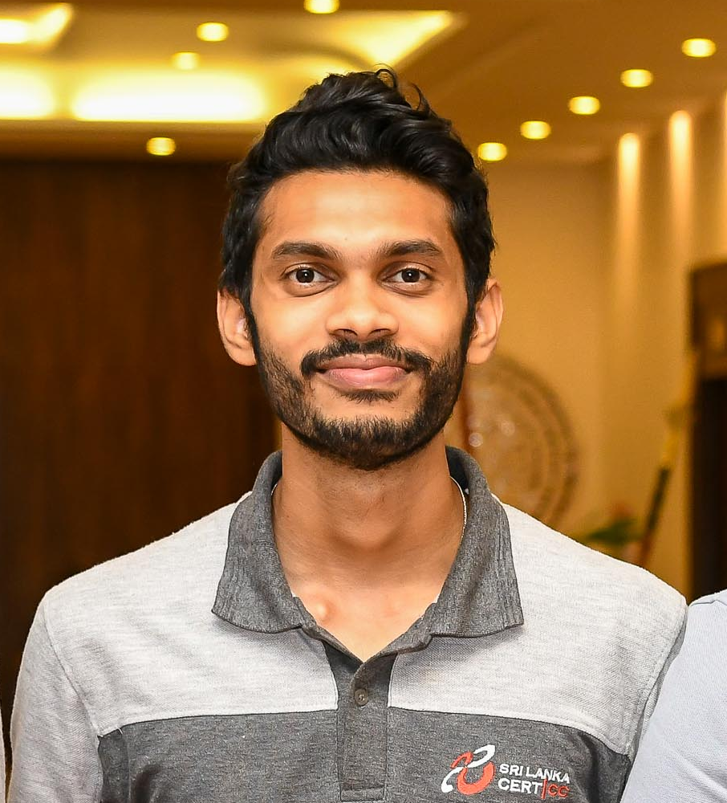

IT17127356 - A.M.S.P.B Atapattu
Bachelor of Science (Hons) Degree in Information Technology Specialized in Cyber Security
10/7/2020
13

Slide 14
BACKGROUND/RESEARCH GAP
When considering a SOHO network, it’s unlikely to find a network with an IPS/IDS due to their high expenses and complexity [1]
In current IoT enabled environments there is lack of easy configure technology to properly secure the communication with IoT devices and track down any potential DDoS attacks and mitigate those attacks.
The goal is to use supervised ML techniques to detect any data packets that will contain malicious content and it will automatically be dropped in scanning stage in the framework.
Feature selection mechanism will be used to detect and build the classifier using various SVM classification[2] ML algorithm.
Hence the DDoS Detection and Mitigation Module of ARCSECURE will be mainly addressing the above gap in existence to bridge it.
IT17127356 – A.M.S.P.B Atapattu 2020-086
10/7/2020
14

Slide 15

RESEARCH PROBLEM
How to detect DDoS attacks and enable mitigation mechanism for protect the devices to enable secure risk free IoT environment
IT17127356 – A.M.S.P.B Atapattu 2020-086
10/7/2020
15

Slide 16
SPECIFIC AND SUB OBJECTIVES
IoT network architecture analyze for find required technologies and tools
Finding Dataset according to the requirements
Test ML algorithms to find out best suitable model
Training the ML algorithm
Testing trained model using dataset
Simulate test attacks to detect accuracy of the model
Implement IoT network statistic monitor and attack log
IT17127356 – A.M.S.P.B Atapattu 2020-086
10/7/2020
16

Slide 17
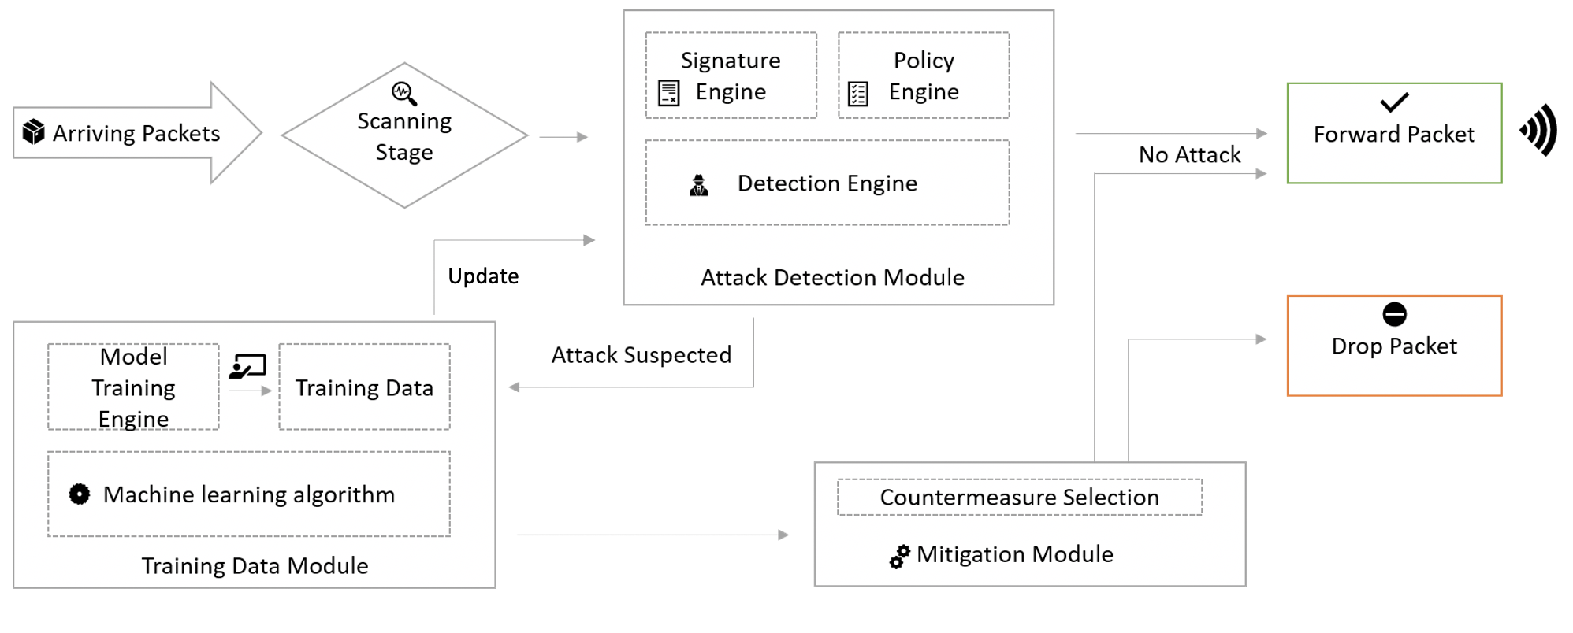
METHODOLOGY AND SYSTEM DIAGRAM
Machine learning based framework for DDoS attack detection and mitigation
Attack Detection
In this stage all incoming packets are scanned and checked for any malicious content
Training Data
If any data packet is attack suspected will be forwarded to here to train the machine learning algorithm
Mitigation
Dropping malicious network packets or forward
IT17127356 – A.M.S.P.B Atapattu 2020-086
10/7/2020
17

Slide 18
ACHIEVEMENTS
Network structure analyze.
Trained and tested the machine learning model for DDoS attack detection.
Implemented a mechanism to drop malicious network packets before entering to IoT environment.
Deploy machine learning model in web environment and desktop environment using chromium engine.
Establish mechanism to check the performance of the ML algorithm.
Created the database and maintain attack log file.
Established a mechanism for the user to view the attack logs, IoT network usage.
IT17127356 – A.M.S.P.B Atapattu 2020-086
10/7/2020
18

Slide 19
REFERENCES
[1] A. Chonka, J. Singh, and W. Zhou, “Chaos theory based detection against network mimicking DDoS attacks,” IEEE Communications Letters, vol. 13, no. 9, pp. 717–719, 2009.
[2] Stylianos Kavalaris and Emmanouil Serrelis,"Multimedia Implementations for SOHO Networks and Their Security Issues " International Journal of Cyber-Security and Digital Forensics , AMC Metropolitan College , 2015.
IT17127356 – A.M.S.P.B Atapattu 2020-086
10/7/2020
19

Slide 20


IT17078306 - H.N Jayawardhane
Bachelor of Science (Hons) Degree in Information Technology Specialized in Cyber Security
10/7/2020
20

Slide 21
BACKGROUND/RESEARCH GAP
Malware can be entered into one’s device/ network without its knowledge at any time. [1]
One main instance is where a user will download and install a version of a software version which could potentially be malicious. [2]
Therefore, it is essential that files are checked before being installed in their devices.
In the modern days, the devices that are readily available does not have the ability to check if the files that have been downloaded consists of malicious content until the user has installed it and the system is compromised. [3]
Therefore, In order to not let malware go undetected and if in case malware is detected there should also be systems in place. Hence it is important to produce a solution to address this gap.
Hence the Malware Detection and Mitigation Module of ARCSECURE will be mainly addressing the above gap in existence to bridge it.
IT17078306 – H.N Jayawadhane 2020-086
10/7/2020
21

Slide 22
RESEARCH PROBLEM
How to detect malware at an initial stage and mitigate it to prevent the system from being compromised?
IT17078306 – H.N Jayawadhane 2020-086
10/7/2020
22

Slide 23
SPECIFIC AND SUB OBJECTIVES
Finding a dataset.
Training malware detection module.
Testing malware detection module.
Logging the files that have been detected as malicious or legitimate.
Enable mechanism to delete file immediately from the system if detected as malicious.
Enable mechanism to execute the file if detected as legitimate.
IT17078306 – H.N Jayawadhane 2020-086
10/7/2020
23

Slide 24
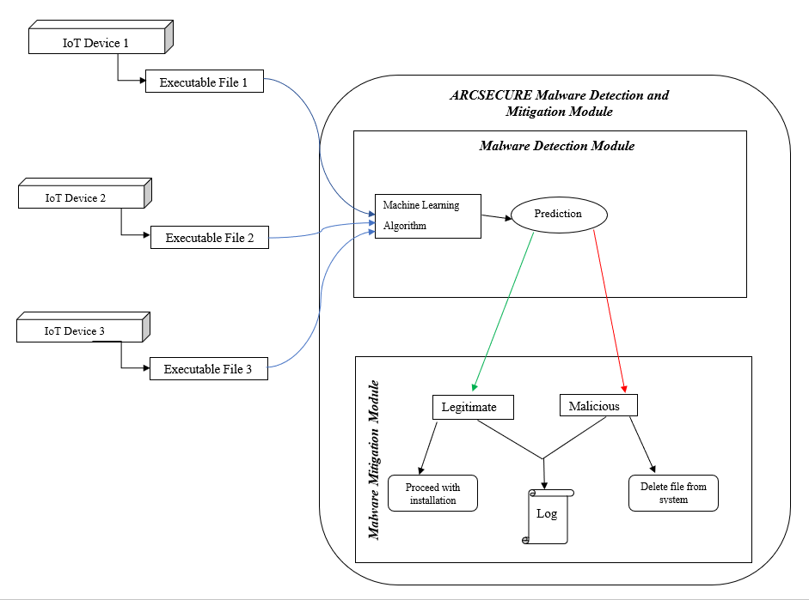
METHODOLOGY AND SYSTEM DIAGRAM
IT17078306 – H.N Jayawadhane 2020-086
10/7/2020
24

Slide 25
ACHIEVEMENTS
Found a dataset.
Trained and tested the machine learning model for malware detection.
Deploy machine learning model in web environment and desktop environment.
Establish mechanism to delete file if detected as malicious.
Created the database and log file to record the files that have been detected as both malicious and legitimate.
Established a mechanism for the user to view the log file.
IT17078306 – H.N Jayawadhane 2020-086
10/7/2020
25

Slide 26
REFERNCES
[1] Z. Zhang et al., “IoT Security : Ongoing Challenges and Research Opportunities,” 2014.
[2] J. Wurm, K. Hoang, O. Arias, A. R. Sadeghi, and Y. Jin, “Security analysis on consumer and industrial IoT devices,” Proc. Asia South Pacific Des. Autom. Conf. ASP-DAC, vol. 25-28-Janu, pp. 519–524, 2016.
[3] S. Wang, R. Claro, and M. L. Pardal, “SPYKE : Security ProxY with Knowledge-based intrusion prEvention,” 2018.
IT17078306 – H.N Jayawadhane 2020-086
10/7/2020
26

Slide 27


IT17126816 - C.N Samarasekara
Bachelor of Science (Hons) Degree in Information Technology Specialized in Cyber Security
10/7/2020
27

Slide 28

BACKGROUND/RESEARCH GAP
IoT devices are resource limited which renders traditional communication protocols
and security schemes inefficient and even infeasible for IoT [1].
In most small scale IoT networks such as a smart home, the router acts as the first line of defence from external threats [2].
With the difficulty in implementing security measures directly to IoT devices. It becomes vital to secure access to the network in which they operate.
A secure and robust user authentication mechanism can not just protect the network but also the router.
IT17126816 – C.N Samarasekara 2020-086
10/7/2020
28

Slide 29
RESEARCH PROBLEM
How can legitimate users securely authenticate themselves into their IoT network?
IT17126816 – C.N Samarasekara 2020-086
10/7/2020
29

Slide 30
SPECIFIC AND SUB OBJECTIVES
Create a 2FA authentication mechanism to verify a user to the IoT network using user credentials verified using Keystroke dynamics.
Choose a suitable dataset for Keystroke dynamics.
Choose a suitable algorithm for Keystroke dynamics.
Develop a ML model for Keystroke dynamics.
Train and Test the ML model.
Create a login functionality for ARCSECURE.
IT17126816 – C.N Samarasekara 2020-086
10/7/2020
30

Slide 31
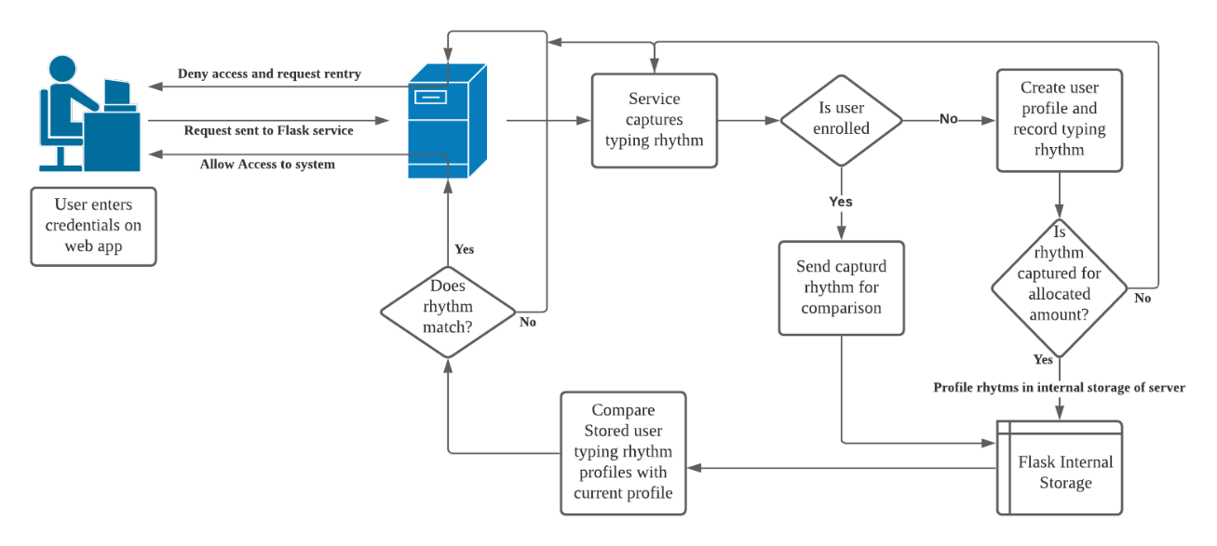
METHODOLOGY AND SYSTEM DIAGRAM
IT17126816 – C.N Samarasekara 2020-086
10/7/2020
31

Slide 32
ACHIEVEMENTS
Completion of a successful implementation of a 2FA authentication mechanism.​
Which requires NO user training.​
Is a cost-effective solution.​
Is an easily deployable model.
Successful completion of creation and deployment of the model on web based and desktop environment.
IT17126816 – C.N Samarasekara 2020-086
10/7/2020
32

Slide 33
REFERENCES
[1] El-Hajj, M., Fadlallah, A., Chamoun, M., & Serhrouchni, A. (2019). A survey of internet of things (IoT) authentication schemes. Sensors (Switzerland), 19(5), 1–43. https://doi.org/10.3390/s19051141
[2] Avast. (2019). Avast Smart Home Security Report 2019. https://cdn2.hubspot.net/hubfs/486579/avast_smart_home_report_feb_2019.pdf
IT17126816 – C.N Samarasekara 2020-086
10/7/2020
33

Slide 34
Thank You!
Questions?
10/7/2020
34

